Slide 1
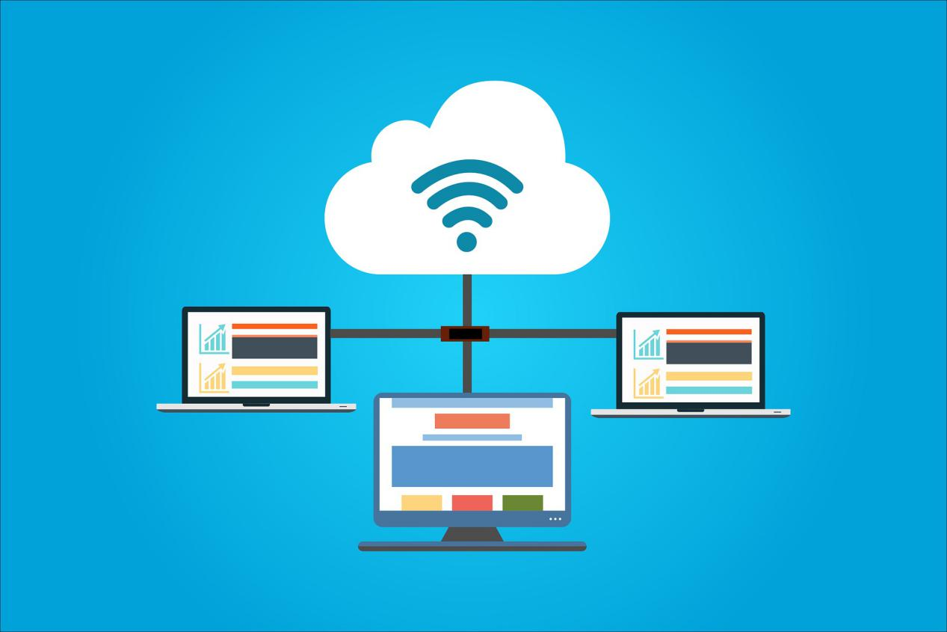

StreamingOS
Low Cost Education System

Slide 2
What is StreamingOS?
Reduce costs of technology in education
Low-cost device, capable of modern day functionality
Streaming operating system to Low-cost device

Slide 3
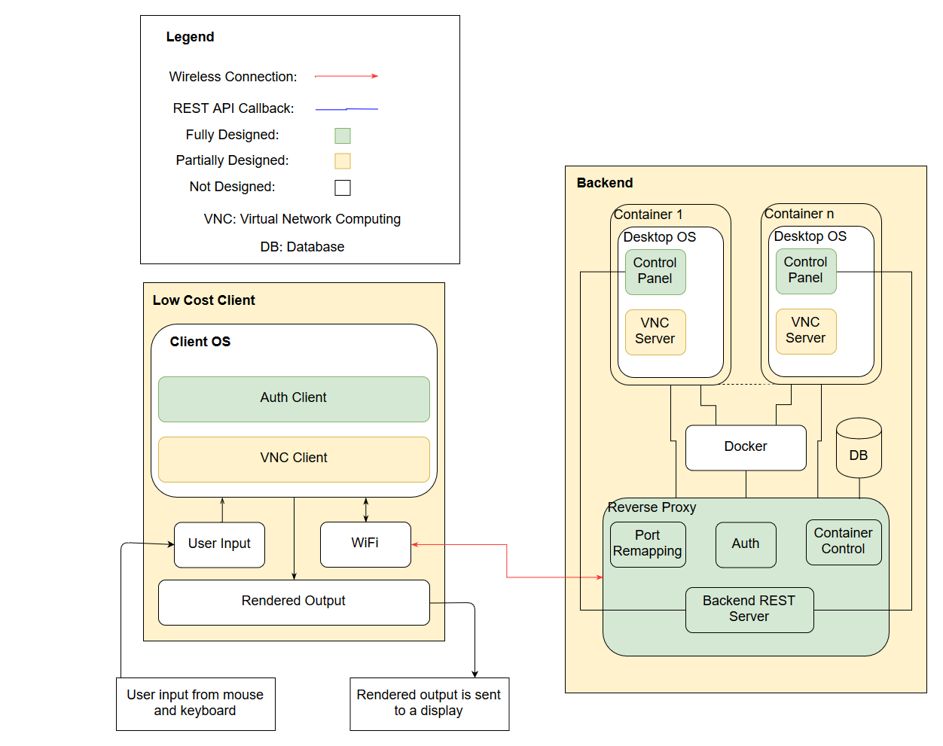
Block Diagram

Slide 4
DEMO

Slide 5
Block Diagram

Slide 6
Project Specifications
Functional Specification
Latency
Teacher Control
Authentication System
Network Connection
Performance
Student Birds Eye View
Secure tunnel for data transfer
Non-Functional Specification
Cost of Device
Reliability
Multi-User Support
Backend server uptime
Portability
Security
Usability
Heterogeneity

Slide 7
Authentication System
OAuth 2.0 protocol is used to authenticate users
Token is granted, and is SSL encrypted
All backend REST calls require an OAuth token

Slide 8
Latency
The end to end latency in our overall system was:
2ms Network Latency => 91ms VNC render latency
8ms Network Latency => 155ms VNC render latency
We can quickly remove or add permissions to an application using the Teacher's Electron application.
Next Steps:
Investigate quick protocol (custom QUIC protocol based streaming server).
Investigate webRTC
Investigate alternate rendering engines that optimally use the GPU on the Raspberry Pi Zero W

Slide 9
Teacher Control
Teacher currently can revoke and grant access to application using the Electron Application
Next Step:
Adding functionality so that the teacher can view live content from the student's screens.

Slide 10
Multi-User Support
Multiple docker containers can be spawned, each with their own port
Teachers and students can use the system at the same time
Individual user configurations are applied when student connects

Slide 11
Network Connection
We use HTTP methods (REST API) for client-server communication
IP tables are used for packet forwarding and load balancing between VNC servers and clients
VNC uses RFB (Remote Frame Buffer) protocol which runs on an encrypted TCP connection

Slide 12
Performance
Three OS containers, reverse proxy container, database container (use approximately 3.75GB RAM, and 11% CPU load)
Host Machine: MacBook Pro 2017
RAM: 16GB LPDDR3
Processor: 2.8 GHz Intel Core i7

Slide 13
Student Birds-Eye View
In the future, the teacher will be able to click on the name of a specific student to see student specific data visually.
This includes data such as their marks, class attendance, etc.
The teacher will also be able view each of his/her student's screen for a better educational experience.
Next Step: This will be implemented using noVNC/WebRTC and Electron in the teacher app

Slide 14
Secure Tunnel for Data Transfer
VeNCrypt is the base security protocol used for an encrypted TLS connection
OAuth 2.0 is used to protect all REST calls
User authentication uses BCrypt

Slide 15
Cost of Device – Core System
Raspberry Pi Zero W: CA $12.99
Link: https://www.buyapi.ca/product/raspberry-pi-zero-w/
Power Adapter: CA $9.95
Link: https://www.canakit.com/raspberry-pi-adapter-power-supply.html
8GB SD card: CA $3.99
Link: https://www.amazon.ca/Kingston-16GBCR-Memory-Universal-Black/dp/B079MDKT2D/
Total Cost: CA $26.93

Slide 16
Cost of Device – Extra Components
Adapter Kit: CA $5.95
Link: https://www.buyapi.ca/product/raspberry-pi-zero-adapter-kit/
Wireless Mouse and Keyboard: CA $24.95
Link: https://www.amazon.ca/Logitech-MK235-Wireless-Keyboard-Mouse/dp/B01AROOL12/
Total Cost: CA $30.90

Slide 17
Reliability
The electron application for the teacher's portal can reliably transmit commands to grant and revoke access of applications to each student.
Read status (database flag) for containers before assigning them
Health check endpoint for each container (Health Checks)

Slide 18
Device Portability
This will be done in ECE 498B
This is a non-essential feature
Next Steps:
Investigate existing inexpensive tablet platforms to run our software
Attach a touch screen to the raspberry pi

Slide 19
Heterogeneity
Electron apps are supported across many platforms.
The VNC protocol is available for all major platforms.
Our VNC client runs on amd64 and ARMv6l platforms
Next Steps: This will be continued in ECE 498B

Slide 20
Other Next Steps
Beautification of the Electron Teacher's Application to convert it into a full-fledged professional application.
Using already developed Bootstrap templates to solve any impending CSS issues that may arise.
Investigate and design a modern User Interface for the Teacher's Electron Application.
Setup user groups in OS Container
User specific storage
Reduce Latency under 300ms

Slide 21


Questions?

